Slide 1
The Use of AI in education
This Presentation was made by:
Nino Inalishvili
Anastasia Gutsadze
Saba Chikhashvili
Nino Zhividze
Keso Keshelava
Davit Skhiladze
Qetevan Zhividze

Slide 2
In the modern world, artificial intelligence (AI) has become one of the most powerful tools in education. It can improve the quality of teaching, simplify the work of teachers, create individually tailored learning resources, and provide students with innovative ways to get new knowledge. Despite these benefits, the spread of AI in education has raised a number of problems that call for the attention of schools and teachers. Therefore, it is important to understand these problems and develop sensible, practical solutions.

Slide 3
The spread of AI in schools and learning environments has raised challenges that are close to each other and form a single chain. One of the most obvious problems is overusing it; instead of doing complex tasks, they ask AI to do everything for them, which weakens their logical and analytical abilities.

Slide 4
The second problem is academic dishonesty, which is worse when students base a large part of their work directly on AI-generated texts, thereby hiding what they really know. In addition to this is the fact that many teachers do not about the applications and systems that verify the authenticity of the work and can determine whether the text is written by the student or created by AI. This is precisely why fair assessment is often difficult.

Slide 5
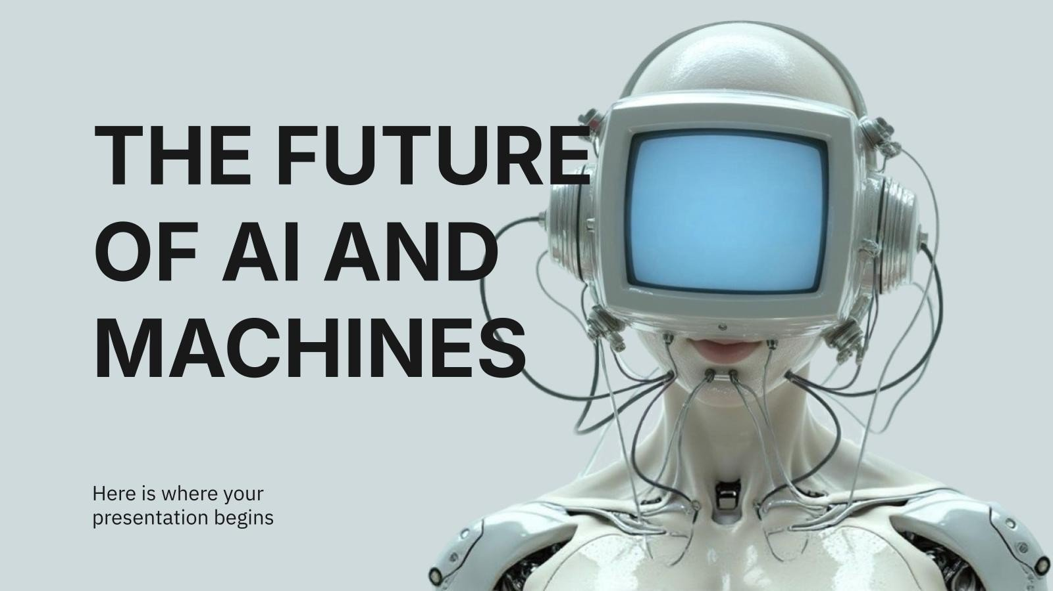

Slide 6
Plagiarism and copyright infringement are also very big problems: many students do not even think that submitting a text created by AI without reading it is actually the same plagiarism as copying text from any source, and not indicating the source where artificial intelligence was used. Finally, one of the serious challenges is the incorrect use of AI. Students sometimes blindly trust the information provided by the system, which may be incorrect, unjustified or completely unreliable, therefore this creates misconceptions and unconfirmed knowledge in them. All these problems together show that despite the benefits of AI, its use should be very careful and based on the right strategies.

Slide 7
In order to minimize the problems listed above, it is necessary to introduce unified, thoughtful and consistent approaches. First, schools and teachers need to establish clear rules about when AI can and cannot be used, so that students do not lose their ability to think independently and do not rely on technology excessively.

Slide 8
Teachers also need to be fully informed about all programs and platforms that verify the authenticity of work, so that the assessment is fair and objective. The teaching process should include a requirement that students clearly indicate where they have used AI and in what part they have relied on it, in order to avoid plagiarism and copyright infringement.
In addition, school programs should definitely include training in how to work with AI correctly: students need to understand that AI can make mistakes, that information must be checked, and that technology is a means of assistance. Teachers should create tasks that require students’ experience, analysis, examples from everyday life, and reasoning based on classroom material. In this case, AI will not be able to completely replace their individual reasoning.

Slide 9
It is also important that schools and educational institutions provide regular training for teachers so that they are constantly informed about the new technologies that appear every day. Ultimately, the main way to solve the problems is to balance the education system and technology in an environment where AI is a useful assistant, but not the main performer, as a result of which neither student skills are lost nor the quality of education is damaged.

Slide 10
PROBLEM VS. SOLUTION
In the end, it is very clear that artificial intelligence is a huge opportunity for education, but this opportunity only gives results when we use it correctly and responsibly. AI is a powerful mechanism for generating ideas, processing information, and simplifying complex processes, which can make learning much more modern and interesting.

Slide 11
But if used carelessly, it can damage the skills that students really need in life: critical thinking, self-reliance, independent learning, and the ability to evaluate information. That is why it is essential that teachers and schools consider both the benefits and risks of AI. The right frameworks, rules, and teaching styles will allow us to create an environment where technology is equally useful for both teachers and students.

Slide 12
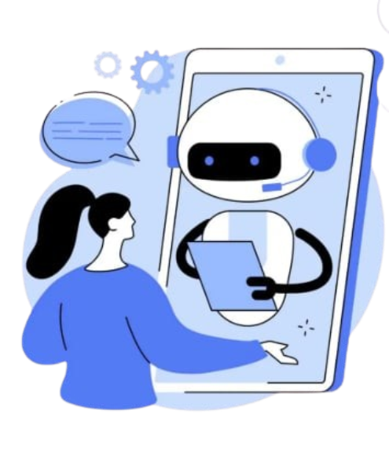
The goal of education should never be to complete tasks quickly. The goal of education is knowledge, self-development, and deepening of thinking. Artificial intelligence can become an important partner in this process if we use it responsibly. With the right approaches, AI will not only not harm education, but on the contrary, will take its development to a new level and make it more modern, flexible, and future-oriented.

Slide 13

Interactive Game
We've already learned how to use artificial intelligence ethically. Let's test our factual knowledge.
Rating:
4 points - you know the topic very well
3 points - it's good, but it could be better
2 points - let's review the presentation
1 point - were you listening?
Start

Slide 14
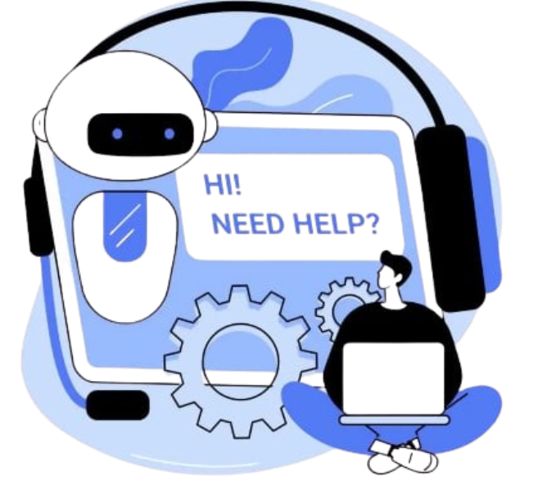
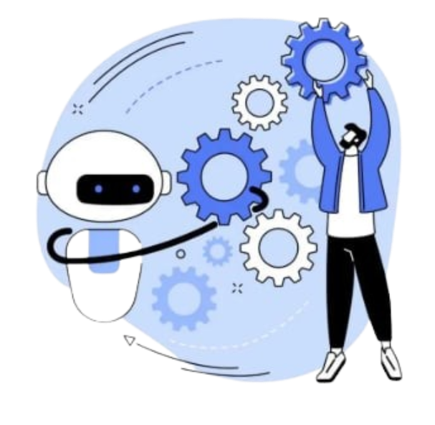
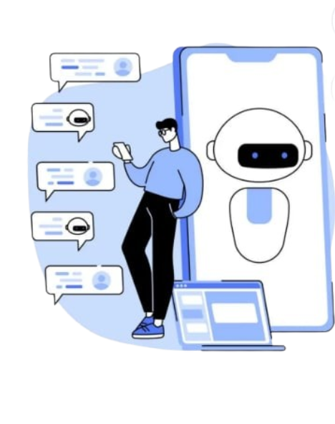
Choose!
End The Game

Slide 15


Case 1
A student has to write an essay about their favorite literary work. He asked AI to come up with ideas.
Is this an ethical way to use artificial intelligence?

Slide 16
The journalist uses AI to sort out the given news materials. Then she checks all the received information first, with reliable sources, before publishing the article.
Is this an ethical way to use artificial intelligence?

Slide 17
The designer receives an image generated by an AI that used protected works of a famous artist or designer during training.
Is this an ethical way to use artificial intelligence?

Slide 18
A student asks an AI to write a scientific article for him. It uses the received text without understanding the scientific terms in it.
Is this an ethical way to use artificial intelligence?

Slide 19
This answer is correct!!!!!!!!

Slide 20
This answer is incorrect!!!!!!!!

Slide 21
https://slidesgo.com/theme/artificial-intelligence-ai-startup-business-plan#search-artificial+intelligence&position-1&results-1458&rs=search
chatGPT.com

Slide 22
Thank you for your attention

