Slide 1
















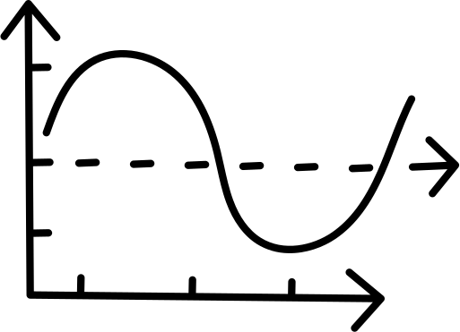

TheSCIENCE
Discover SCIENCE with us!

Slide 2











1
Having a few numbers of science-related courses
2
Lack of clear explanation in the content
Problems
3
Non official and unknown sources
4
Non official certification

Slide 3
1
Presenting more courses about
Explanation by professional instructors
2
Solutions
3
Reliable sources
Official certifications and giving reference for hardworking students
4

Slide 4


Slide 5


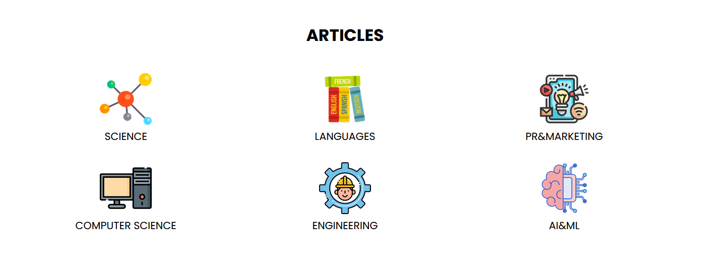

Slide 6
 | SAFAVY | TheSCIENCE | INNAB | ELMX
Reliable courses
Mainly scientifical courses
Giving officially certificate
Giving reference
Presenting scientifical articles

Slide 7
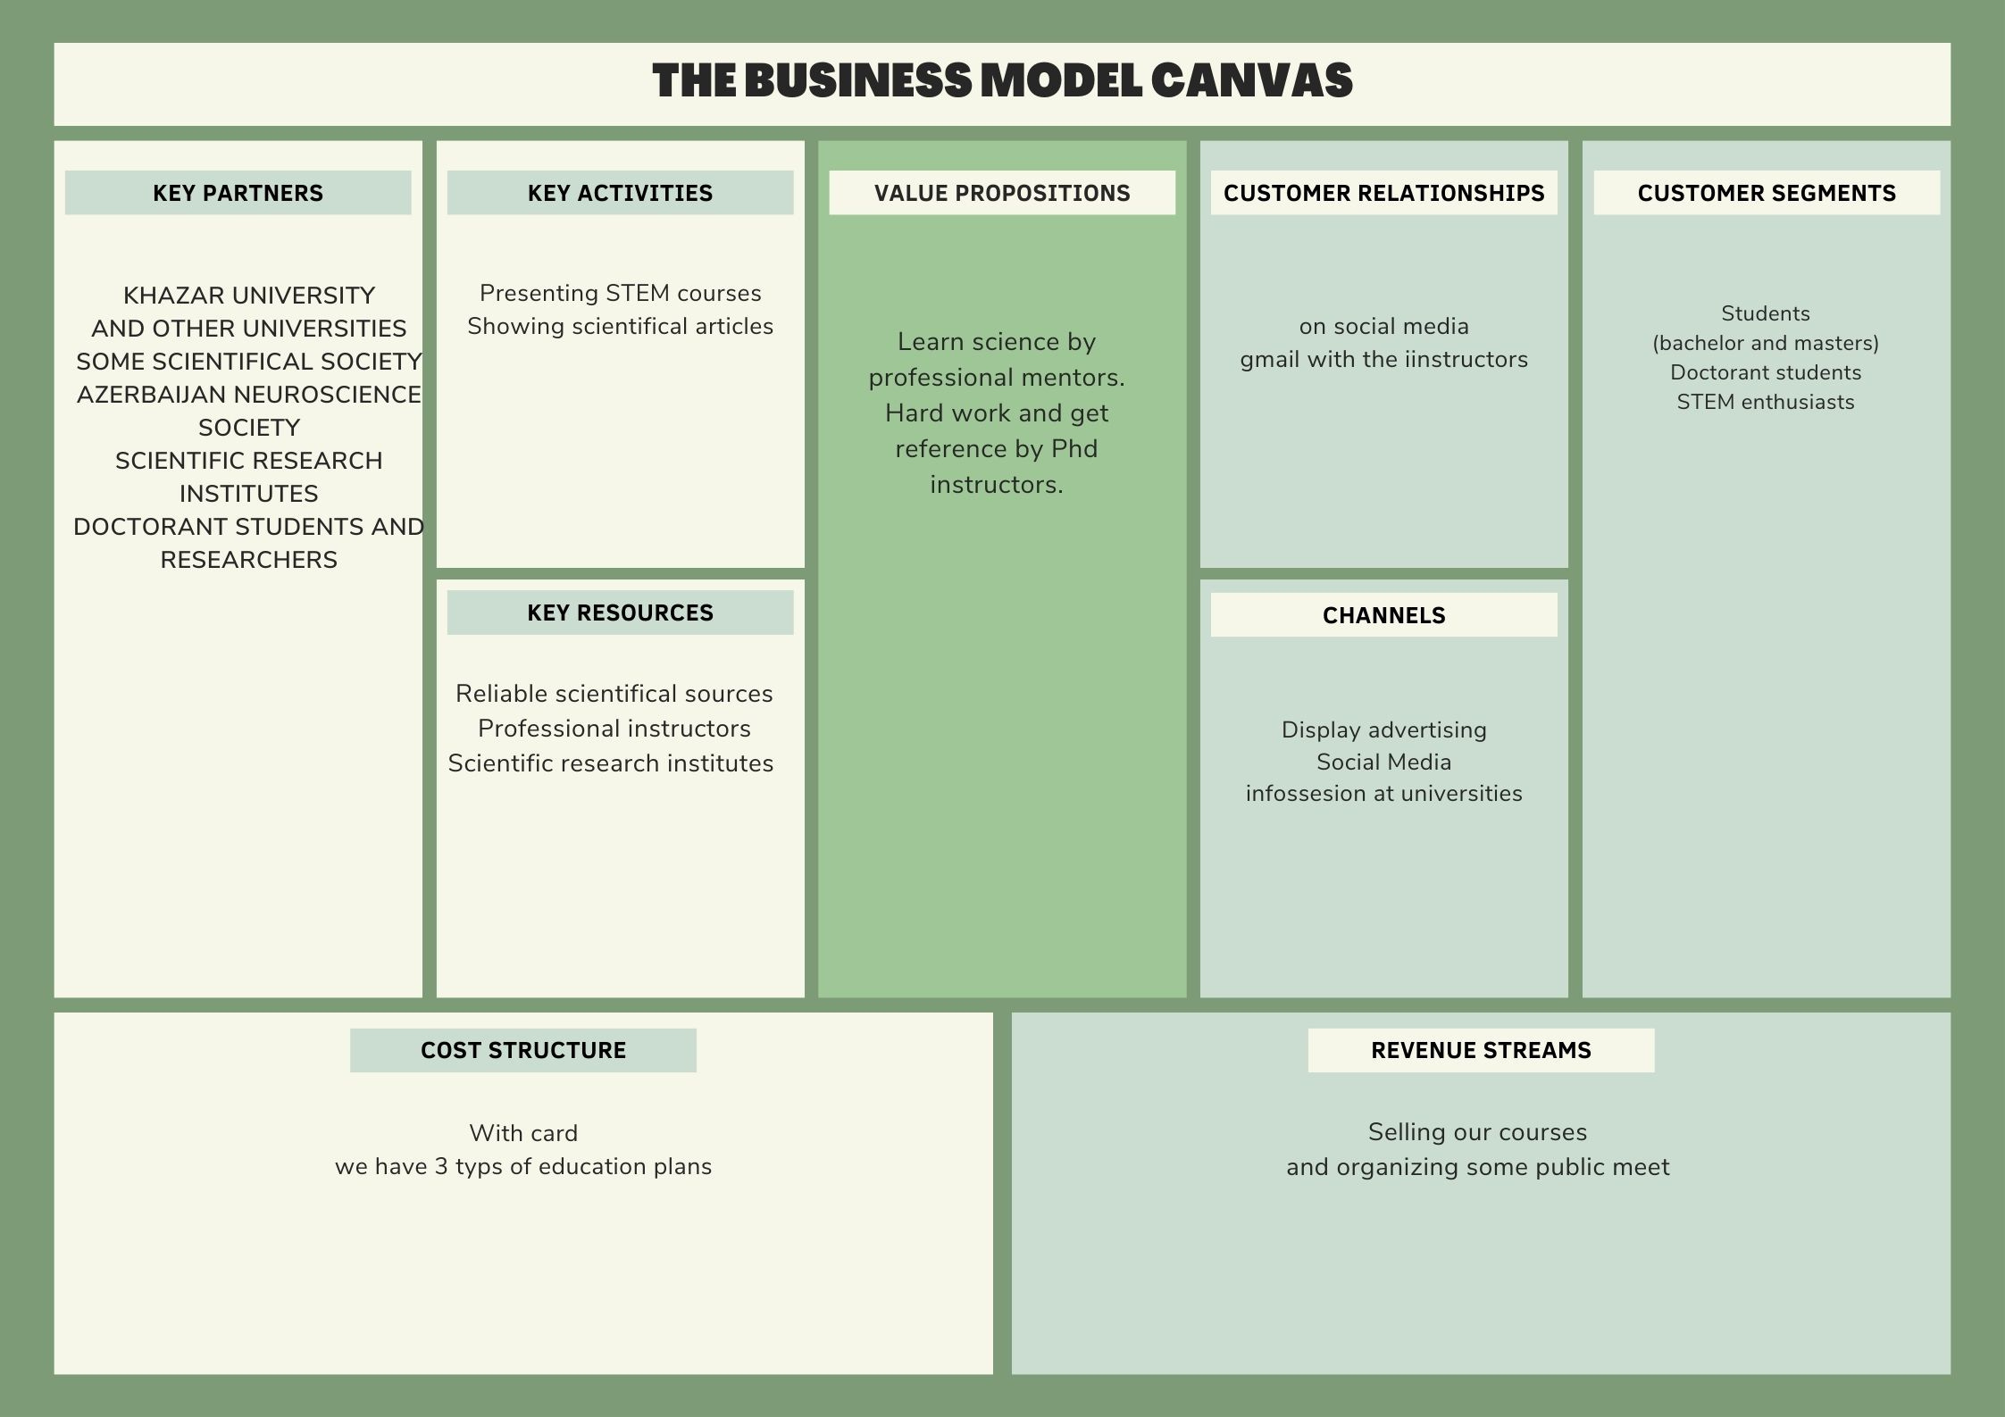

Slide 8
Premium
500 manats per year
Basic
50 manats per month
Standart
275 manats 6 months

Slide 9


Slide 10
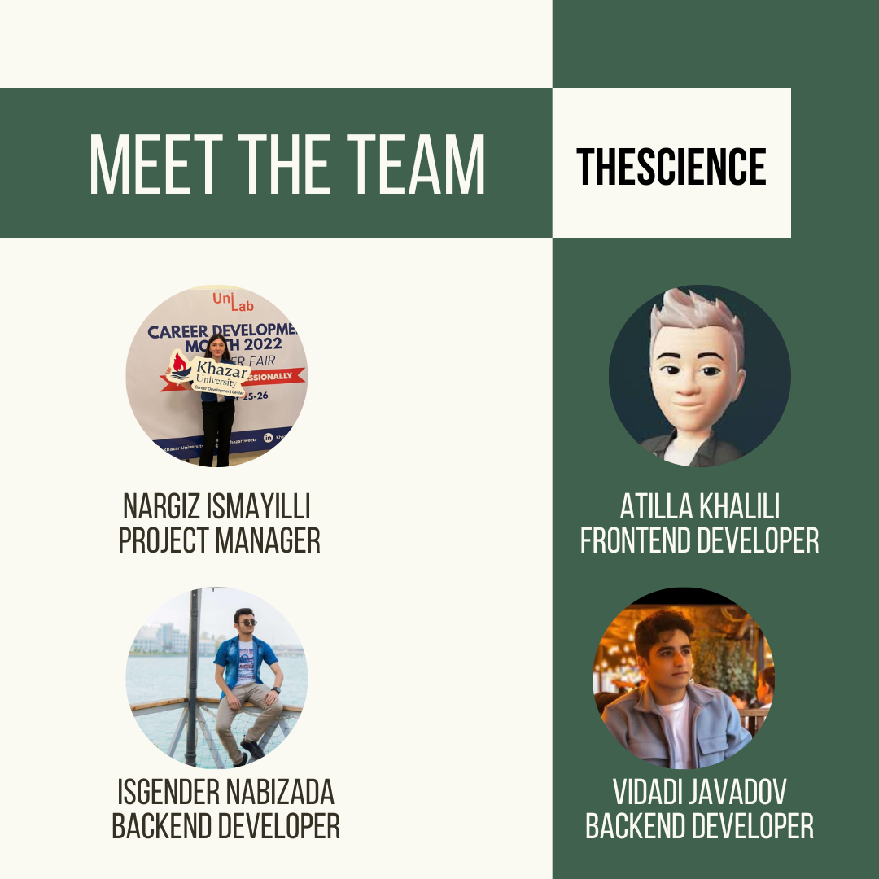



CONTACT
0704062004
NARGIZ ISMAYILLI
nargiz.ismayilli2021@khazar.org

Slide 11












That's a wrap!
Thank you for participating!

