Slide 1

STEAM4Sustainability Hack
Team: ECOFIND

Slide 2
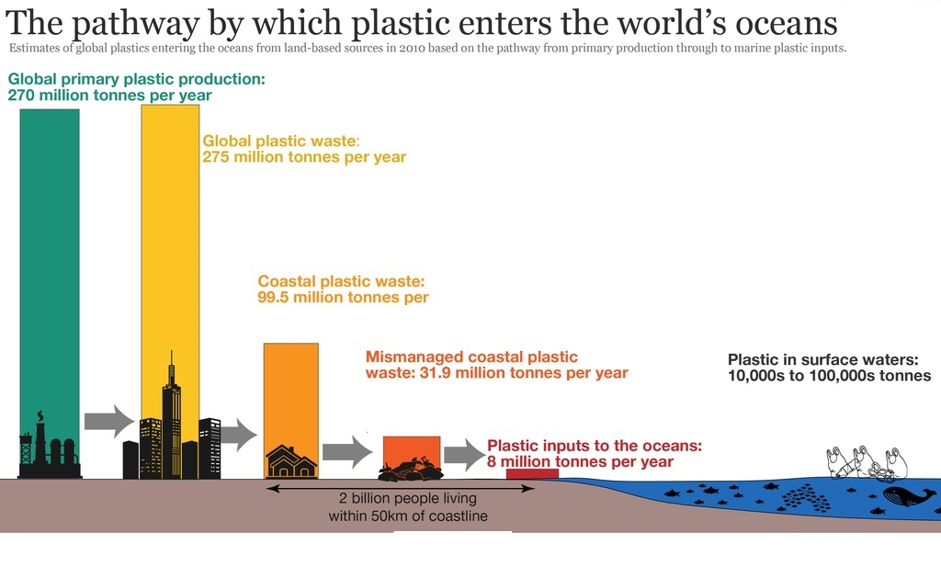
The Pathway by which plastic enters the world’s oceans
https://www.mdpi.com/2071-1050/15/17/13252

Slide 3
OUR MISSION
OUR MISSION IS TO PROMOTE SUSTAINABILITY, REDUCING THE ENVIROMENTAL IMPACT IN A FUN WAY
BECAUSE:
LESS POLLUTION AND WASTE → HEALTHIER AND CLEANER OCEANS

Slide 4



Offline ModeScan
Your products from one end of the store to the other.
SearchBar
For any product by typing its name.
Item Pollution
Through our database in which we have all the information about the product.

Slide 5
Our sustainability criteria
Products
  Environmental impact
  Materials/ingredients
  Packaging
  Ethics and Transparency
  Carbon footprint and CO2
  Durability and Recycling
  Data sources
Companies
Material Flow Analysis (MFA)
Life Cycle Assessment (LCA)
Carbon footprint
Water footprint

Slide 6
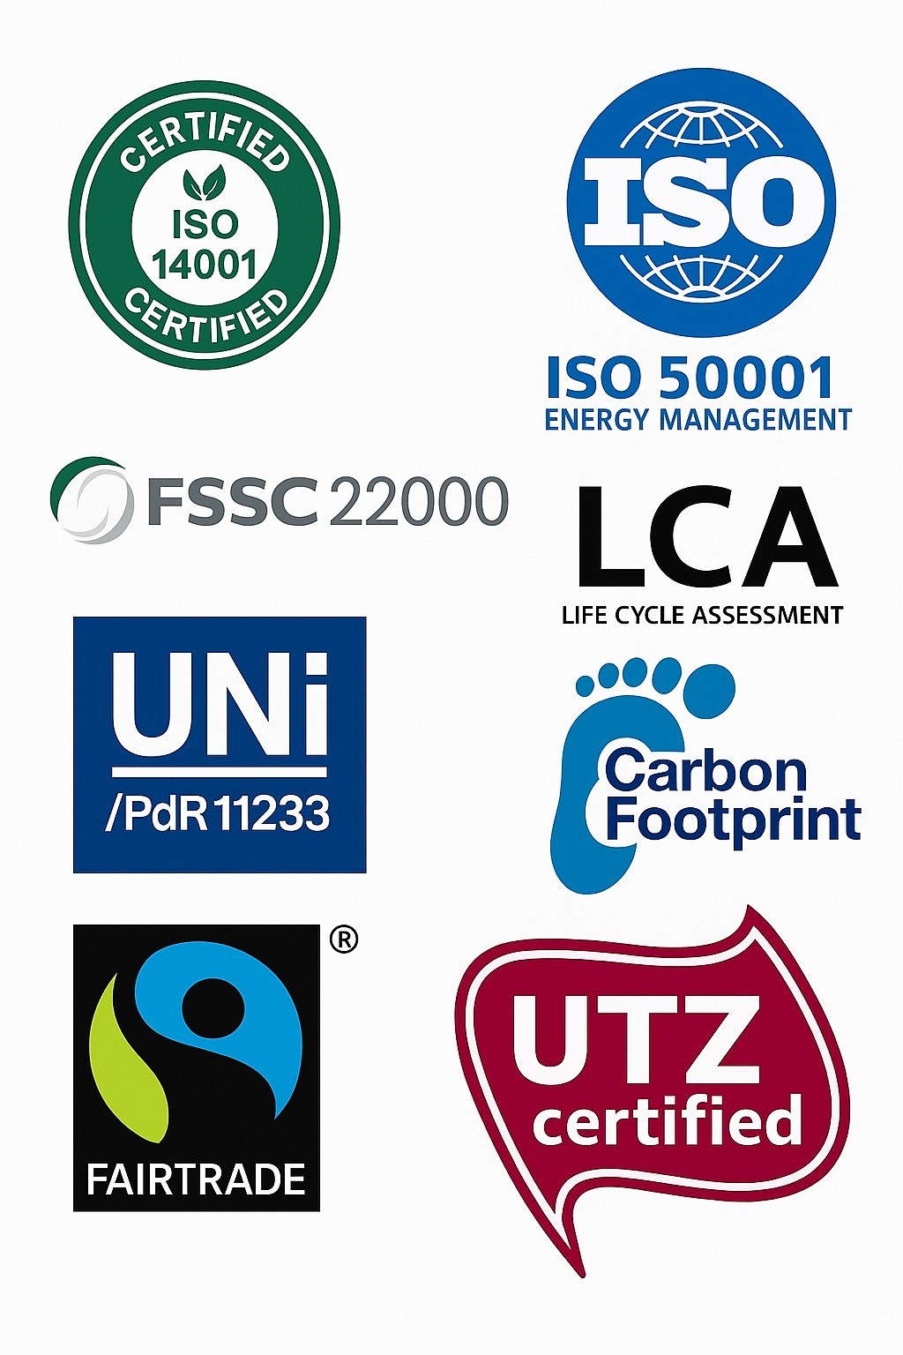
Certifications

Slide 7
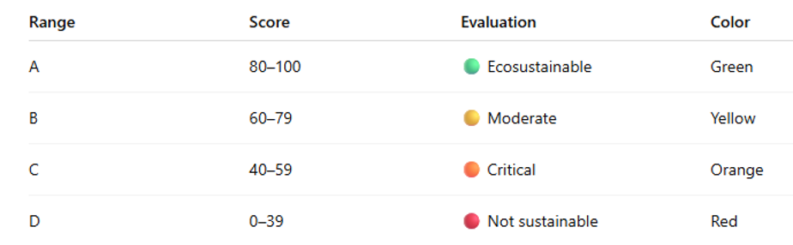
Rating brackets

Slide 8
Each action matters, each choice makes the difference:
With our app we can convert sustainability in a movement,
then the movement in FUTURE

Slide 9


