Slide 1

STEAM4Sustainability
Hack - EcoLink
Team:
Ângelo Abranja, Fábio Sampaio, Mateus Silva, Maria Soeiro, Patrícia Neves
11/11/2025

Slide 2
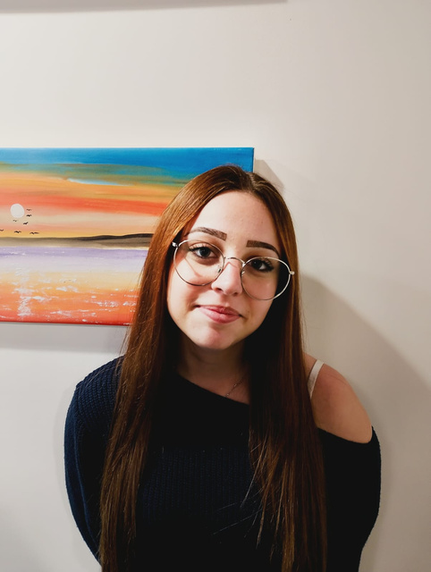
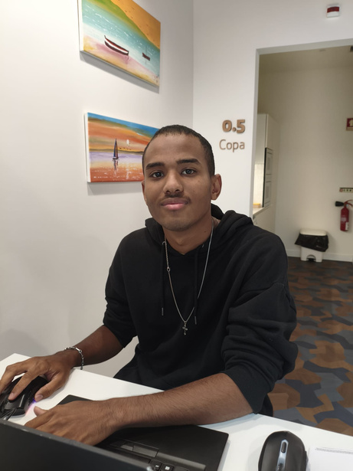
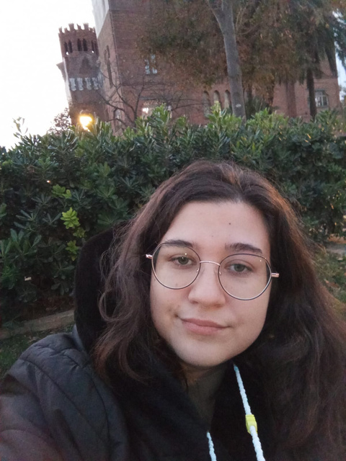
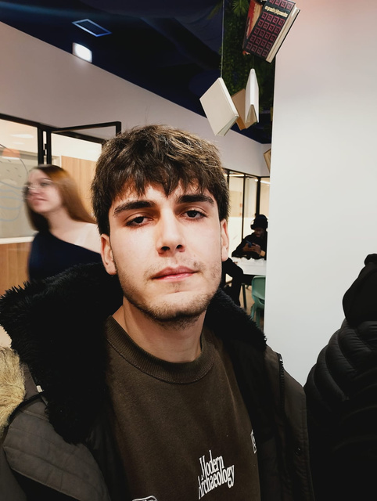
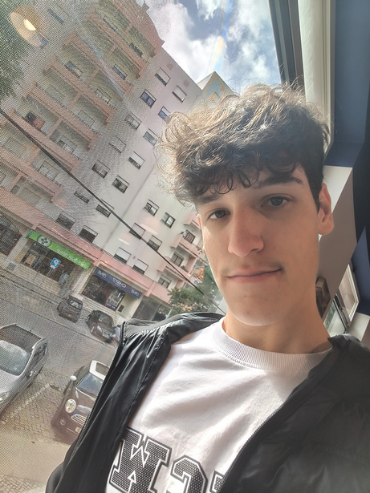
Team Roles
Team Leader:
Mateus Silva
Designer:
Patrícia Neves
Researcher:
Maria Soeiro
Tech Expert:
Ângelo Abranja
Communicator:
Fábio Sampaio

Slide 3

INDEX
1
5
The Problem
Brand Partnerships
2
6
Communication & Launch Plan
Our Solution: EcoLink
3
7
Impact & Vision
How It Works
4
Gamification & Engagement
8
Closing Message

Slide 4

THE PROBLEM
Pollution keeps rising.
  Every year, millions of tons of recyclable waste still end up in landfills.
  People want to help — but lack motivation, connection, and visibility for their impact.

Slide 5

OUR SOLUTION: ECOLINK
  EcoLink is a social network that turns recycling into points, rewards, and community impact.
  Users scan a QR code or NFC tag when recycling at partner stores (Lidl, Pingo Doce, etc.).
  The system records materials, calculates eco-points, and transforms them into measurable results

Slide 6

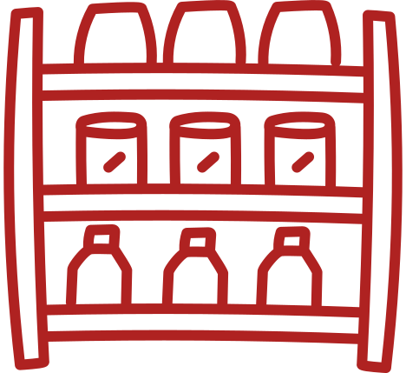

HOW IT WORKS
DIGITAL PLATFORM
PERSONAL PROFILE
INTEGRATION
Track recycled materials and earned points

Slide 7
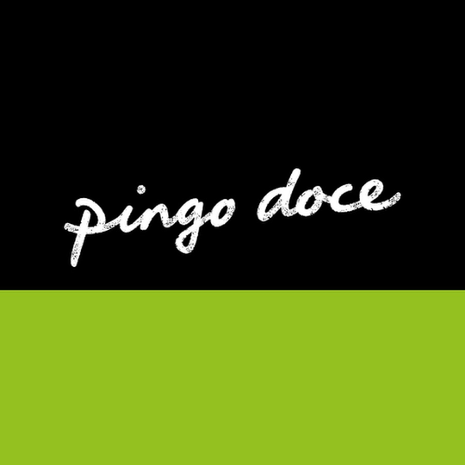
BRAND PARTNERSHIPS
For Partners (e.g., Lidl, Pingo Doce):
  Stronger green and blue brand image
  Increased store traffic
  Access to impact data (total materials recycled)

Slide 8

BRAND PARTNERSHIPS
Co-Branding Campaigns:
  “Recycle and get 10% off”
  “For every 100 bottles recycled, we plant a tree”

Slide 9

COMMUNICATION & LAUNCH PLAN
Launch Campaign:
  Events with influencers and eco-ambassadors
  Social media teasers (Instagram, TikTok, LinkedIn)
  Partnerships with schools and universities

Slide 10
COMMUNICATION & LAUNCH PLAN
Visibility Tools:
  Real-time recycling counter on website
  In-store screens showing Top Recyclers of the Week

Slide 11

IMPACT & VISION
Expected Results:
  Higher recycling rates in Portugal
  Stronger brand ESG engagement
  A connected, eco-conscious community

Slide 12

IMPACT & VISION
Vision:
  Start regional — grow international.
  EcoLink will be the first social network built entirely around sustainability.

Slide 13

CLOSING MESSAGE
EcoLink – Connecting people, brands, and the planet.
  Together, we turn pollution into participation.

Slide 14


