Slide 1

STEAM4Sustainability Hack
Team: SG2
Members: Karmo, Albert, Markor, Loore, Helerin, Adeele

Slide 2
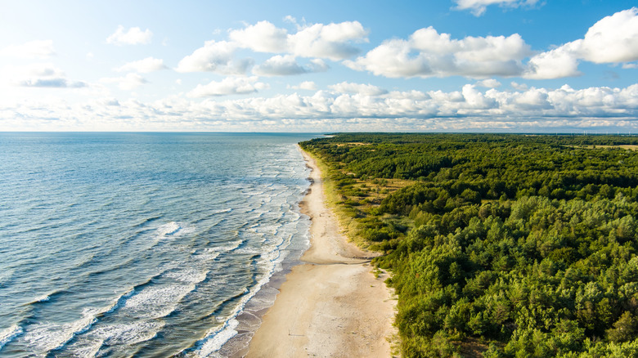
Floating sensor for Ocean Pollution Detection and Cleanup
SG2
Loore, Helerin, Adeele, Markor, Albert and Karmo
2025

Slide 3
Our problem
The Baltic Sea is full of microplastics, oils and toxic chemicals.
Between 1945 and 1947, the Soviet Union dumped nearly 65,000 tons of chemical weapons into the Baltic Sea, which are now rusting and leaking.
We don’t have enough tools to see where leaking and pollution happens and clean up before it affects the marine environment.

Slide 4
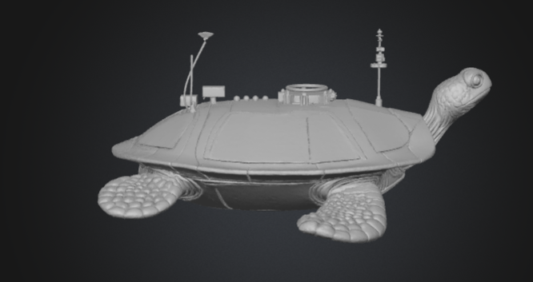







Our solution –turtle-shaped floatation device made from recycled materials
Oil collection tank
Antenna
360° cameras
Filtered Water Outlet
Moving head
Length: 1m
Solar panels
Oil, chemical filter
Sensors

Slide 5
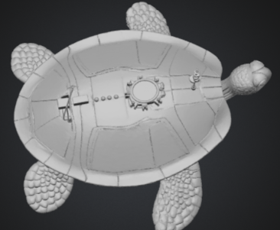
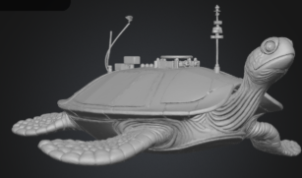
Additional angles and info
Turtle sends the collected info to an app which can inform people of the real-time data on sea pollution.
Turtle collects microplastics and oil using special membranes and magnets.
Powered by renewable energy.

Slide 6
For raising awareness- A game for youngsters
For children aged 8-12
Teaches:
responsibility
compassion
importance of keeping our seas clean
awareness of the condition of the sea

Slide 7
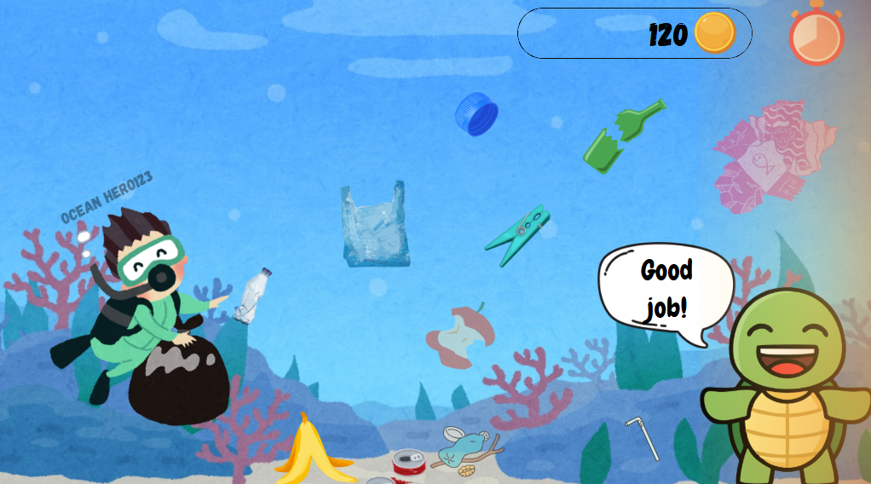
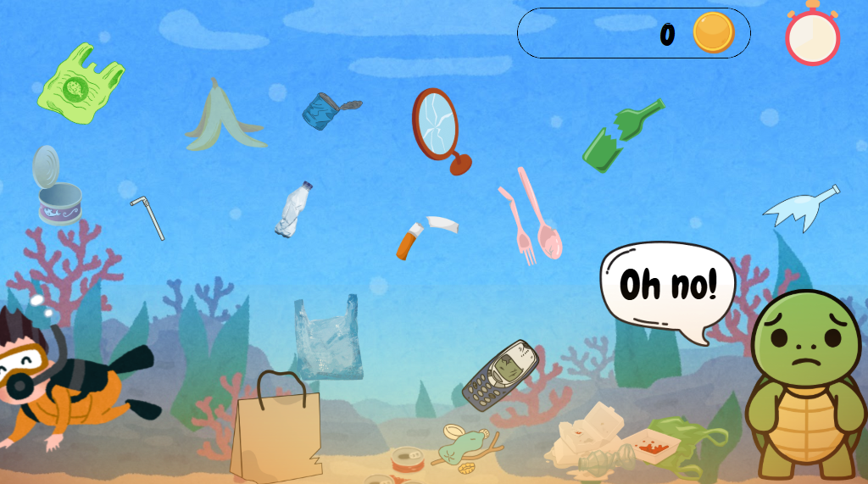
Gameplay Canva
The player is rewarded for helping the sea
When the player ignores the problem, the level is failed

Slide 8

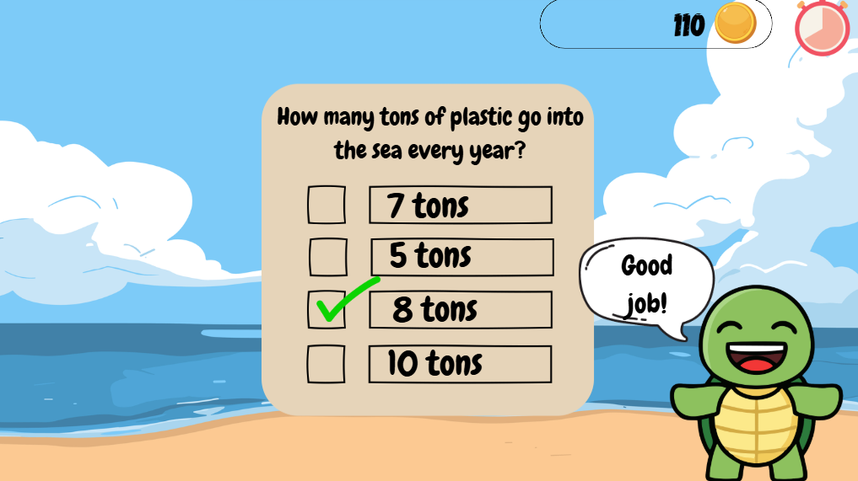
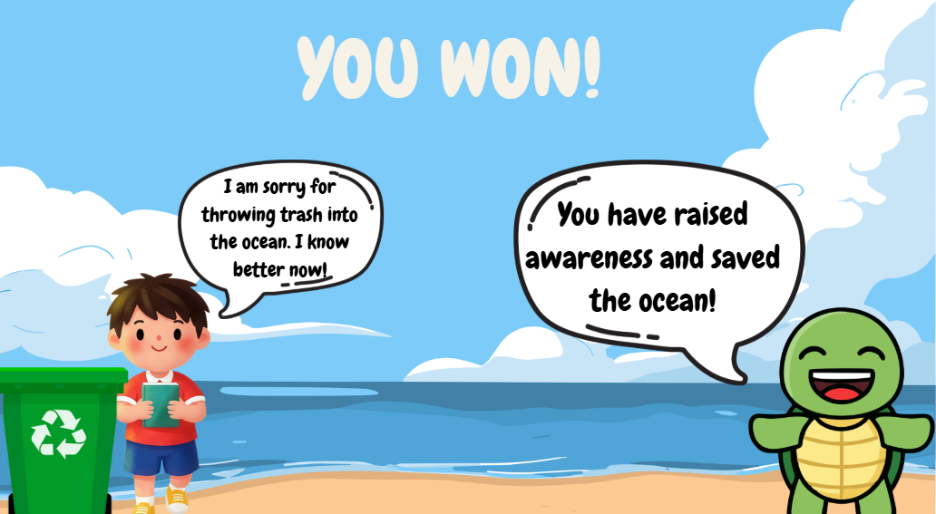
Educational questions
Children are encouraged to learn facts about the sea
After answering wrong, kids can try again
The end!

Slide 9
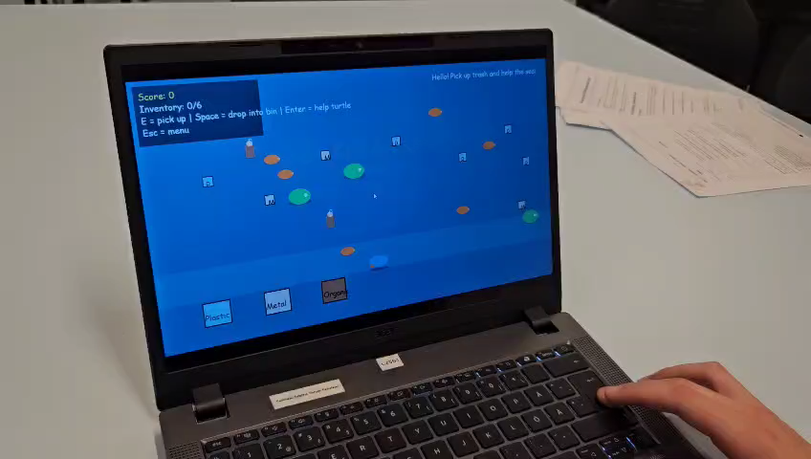
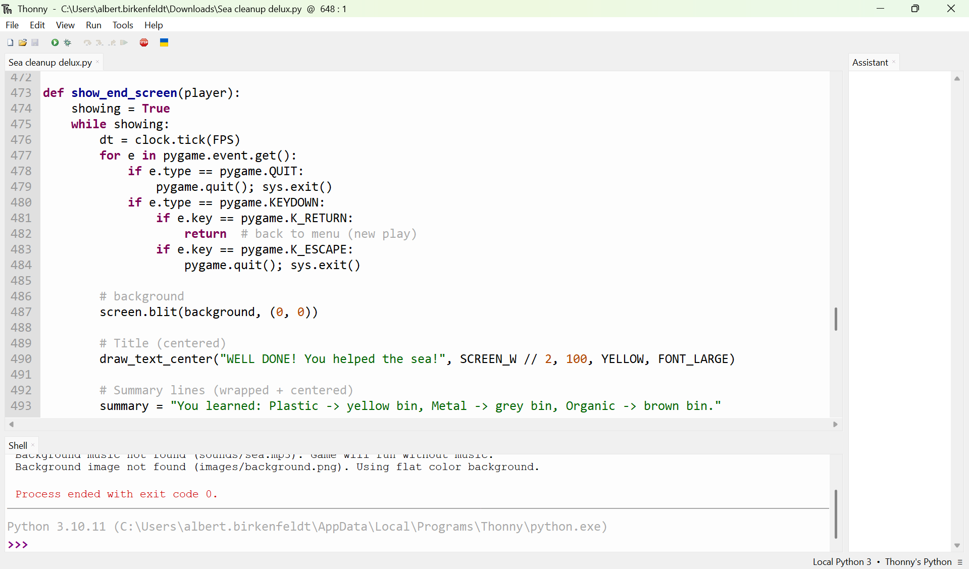
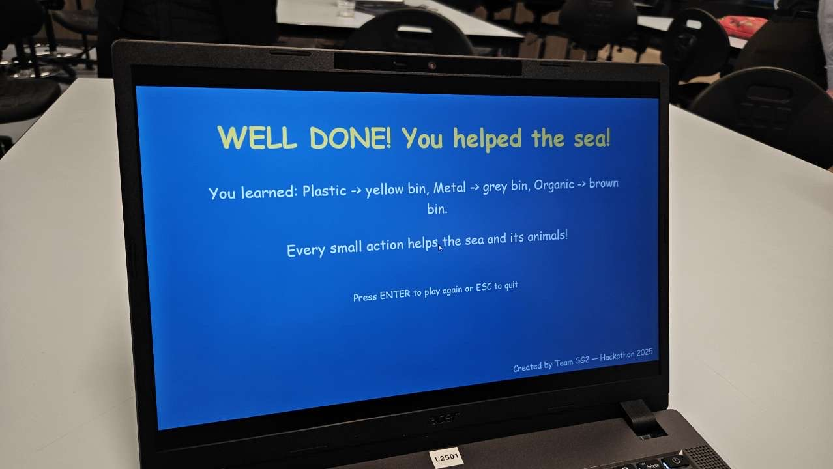
SEA CLEANUP DELUXE
We coded a prototype of the game.
Sorting trash and helping turtles.

Slide 10
Citing sources
Detection of Marine Oil Spill from PlanetScope Images Using CNN and Transformer Models
Design and Validation of an Eco-Compatible Autonomous Drone for Microplastic Monitoring in Port Environments
Development of the Artificial Intelligence and Optical Sensing Methods for Oil Pollution Monitoring of the Sea by Drones
Toward Large-Scale Autonomous Monitoring and Sensing of Underwater Pollutants
Using Robots to Clean Oil Spills | RoboticsTomorrow
https://www.err.ee/
https://saartehaal.postimees.ee/
https://en.wikipedia.org/wiki/Baltic_Sea
https://helcom.fi/baltic-sea-trends/hazardous-subtances/sea-dumped-chemical-munitions/?utm_source
Teadlased on eri meelt, kas Läänemerest vana sõjamoona väljatoomine on ohutu | Eesti | ERR
Canva: visuaalne komplekt kõigile
https://www.meshy.ai/discover

Slide 11
"The sea"
You people who brought troubles to the sea,
Come together – conspire, rebuild your waters
that sea which once fed you.
O nation, you who fouled the deep,
the sea that sustained you -
O you who now dread the waves,
Why would you lay waste to your own ocean?
O human, undo your error and
save what you have already doomed.
The more we harm, the sharper the pain.
So rise, people – let us lift ourselves as one,
with all our force,
to uproot
our own wickedness

Slide 12


