Slide 1




practonic.com
Let's practice

Slide 2
What is the practonic.com? What is it used for?
Allows to gain real work experience
Connects Developers
Allows to increase their level and makes competition
Allows to earn income on our platform

Slide 3


No Work Experience
Less Practice
You are not enough
Non-communicativeness
Incorrect Roadmap

Slide 4

30
27.7M
28.7M
NUMBER OF SOFTWARE DEVELOPERS WORLDWIDE IN 2018 TO 2024
26.9M
24.5M
25.6M
23M
23.9M
20
  The annual growth rate for developers is 3.6%
10
0
2018
2019
2020
2021
2022
2023
2024

Slide 5
Survey between developers
8%
Would you like to work remotely while gaining experience and earning income, collaborating with developers or developer friends from various parts of the world
Blue: Of course
Red: No
92%

Slide 6




THAT'S WHAT I AM TALKING ABOUT
Practice
Real Work Experience
Communication
AI-supported Roadmap and Recommendation System

Slide 7


WHY US?
freelancer.com
fiverr.com
01
Real-world work experience through the placement of paid and unpaid projects
02
Top developers earn extra
03

Slide 8
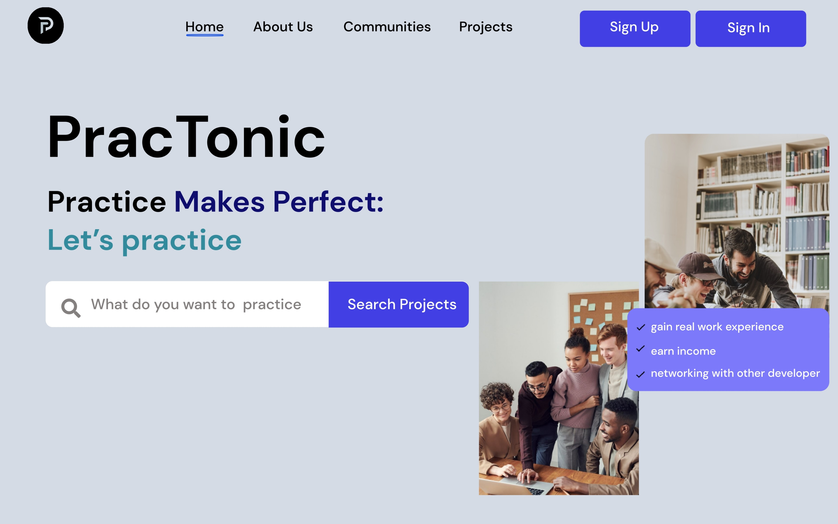
Product Design

Slide 9
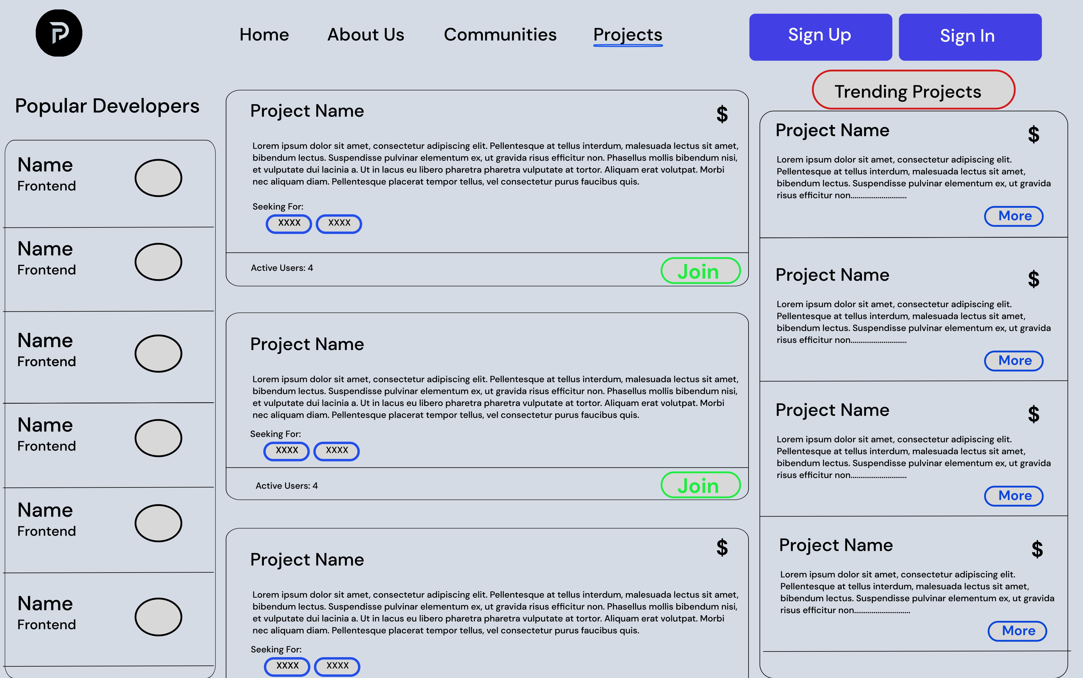

Slide 10
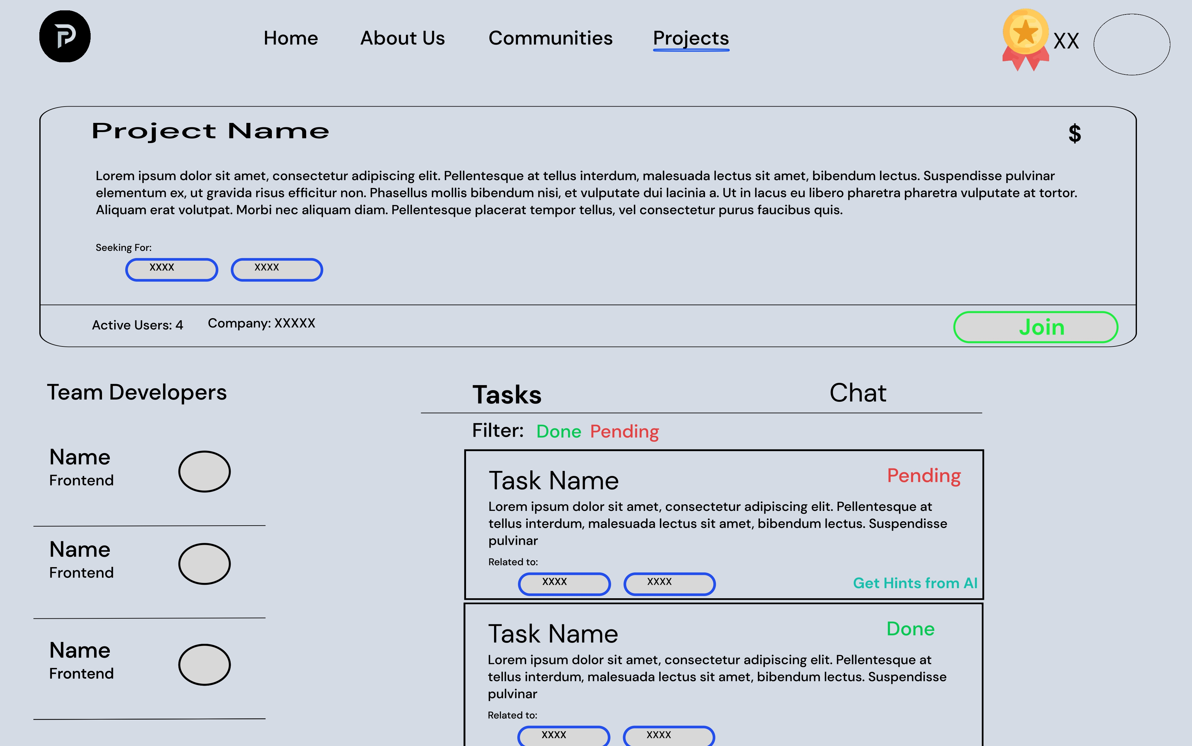

Slide 11
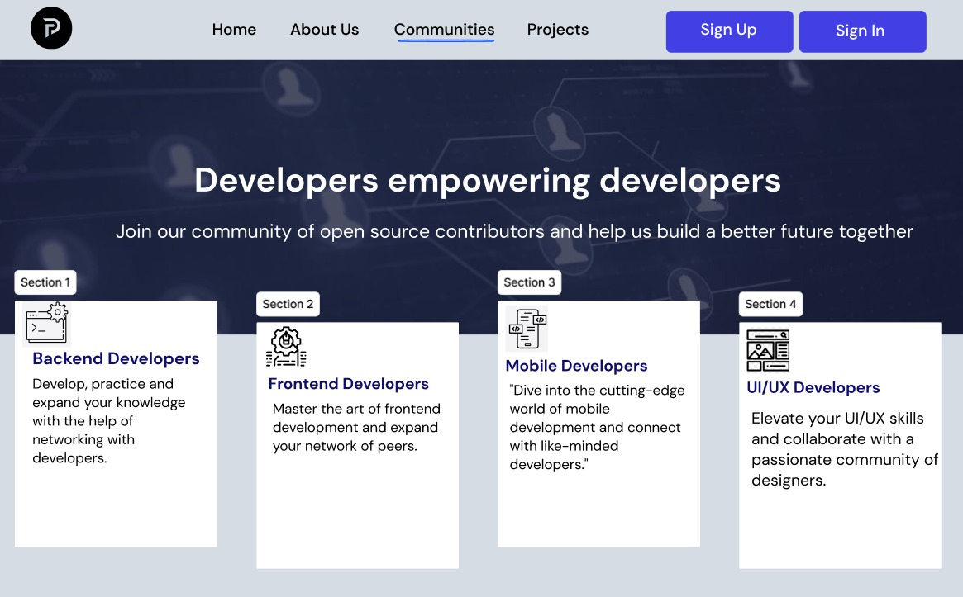

Slide 12
Business Model
Income Types
Subscription | Partnership | Services
Fixed | Dynamic | Dynamic
Customer Segments
Software Developers | Students | Product Owners | Courses | Companies | Freelancers | Educators
27,7 mln | 202,17 mln | 2,5 mln | 1 mln | 96 mln | 21 mln | 3,5 mln

Slide 13






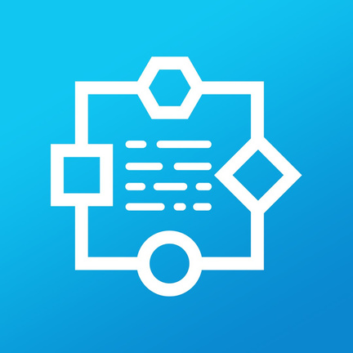




KEY PARTNERS
Local
Global
Tech Academy

Slide 14






Oruj Hummatov
Safar Jafarli
Product Owner
Backend Developer
TECHTONIC
Narmin Teymurlu
Murad Mazanli
UI/UX Designer
Frontend Developer

Slide 15


practonic.com
Practice Makes Perfect
Let’s Practice

