Slide 1



14/11/2024
Easier Description for Future Careers
Mehrdad Ebrahimi
Position
DigiEduHack 2024 Organising Partner
DigiEduHack is an initiative under the Digital Education Action Plan (2021-2027) of the European Commission

Slide 2

TABLE OF CONTENTS
01 – Choosing wisely
02 – First Step
03 – Gathering Data
04 – Tree of possibilities
05 –conclusion and Members

Slide 3


01
Why is important choosing wisely future job
Long-Term Satisfaction
Financial Stability
Career Growth
Work-Life Balance
Job Market Demand

Slide 4
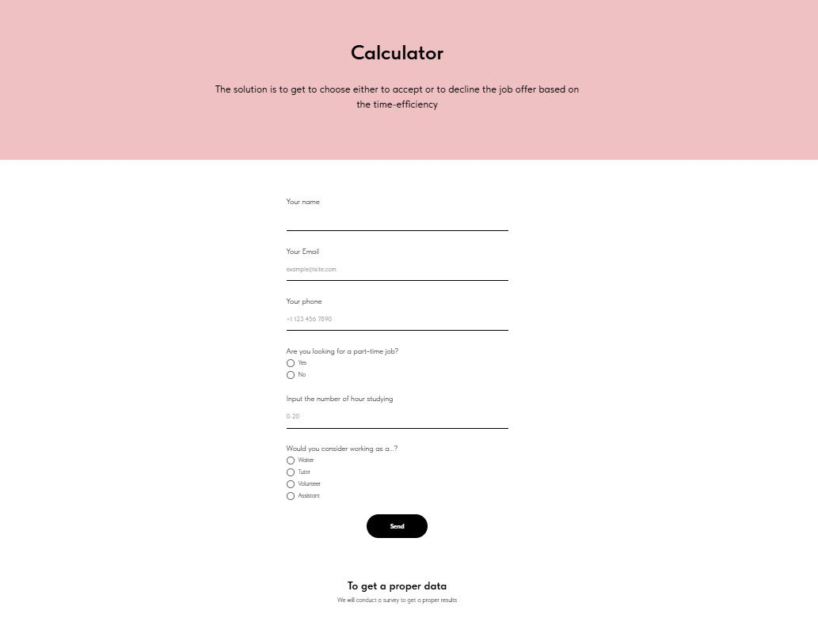
02
First step
Survey in Website
Student Before graduation
.Willing
believes
Student After graduation
Data
Experience
Processors and experts
. Idea
. Experience
1. When did you graduted
2. What was your grade
3.In 5 year what was your salary
4. In 10 years what was your salary
5. What position did you hold after 5 years?
6. What skills did you develop during your first job?
7.Did you switch careers or stay in the same field after 10 years?
8.How did your responsibilities change over the years?
9.What major challenges did you face in your career, and how did you overcome them?

Slide 5
03
Gathering Data
New data base
New survey
Old data base
We are gathering all data to show that what they are willing to offer is tailored to the user's needs and preferences, allowing for more personalized experiences and targeted content. This data collection often includes tracking browsing behavior, purchase history, and even interactions
Import
export
case
AI
Result

Slide 6
04
Tree of possibilities Algorithem
Accepting Job
yes
time of graduation
grade
No
time of gradation
grade
salary in 5 years
salary in 5 years
If yes accept in 3 month
Salary 5
Salary 10
grade
In the under possibilities, I can give you the percentage probability of it happening.

Slide 7
05
Conclusion
The decisions you make today, especially regarding your career and personal choices, can have a significant impact on the quality of life you lead in the future. Making informed and thoughtful decisions early on can help ensure a successful and fulfilling life ahead.
It is better use advance tools we have today
Logo:
Members of Team
Alessandro Oppo
Mehrdad Ebrahimi
Sofia
Veronika Ten

Slide 8

THANK YOU!

