Slide 1





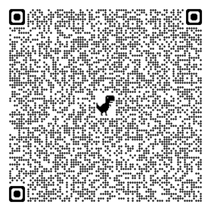

InnoEduHack 2025
📅 It’s November 14th, 9:00 AM CET.
You now have 24 hours to develop your solution for the future of education.
You can work individually or in teams of up to 5 people.
👉 Each team member must register separately - LINK
👉 Only one person per team needs to upload the final project.
💡 15 prizes of 300 EUR each will be awarded per project, not per person.
🕘 Deadline: November 15th, 9:00 AM CET.
Please submit a one-page solution (this page + one page for your solution).
TEAM INFORMATION:
Team name: _________________________________________________________________
‼️Meta-Category is: Digital Transformation & AI – all ideas should address changes driven by digitalisation and new technologies, especially AI.
Select Your Category (choose one):
☐ Assessment & Grading – new models for evaluating student performance
☐ Teacher Support – tools helping educators deliver engaging classes
☐ Student Support – solutions that improve the learning experience
Recommended Solution Template:
1. Problem Statement: One-sentence definition of the problem (the essence).
2. AS IS: Current Situation: Describe the context with data and pain points. Why is solving this problem essential?
3. Game Plan: Your Solution: How do you get there? What’s your approach or process?
4. Technology (optional): You don’t need to code it! But a mockup or simple sketch of functionalities increases your chances.
5. Vision of Success: How will the user experience change? How will you measure success (KPIs, outcomes)?
Evaluation Criteria
✅ Creativity – originality and novelty of the idea
✅ Feasibility – practicality and potential for implementation
Hackathon Support
💬 Microsoft Teams link:
Join the meeting now:
Meeting ID: 388 725 417 436 34
Passcode: JM9HW3tP
No. | Name & Surname | University If ALK student, include the year of studies, the name of the program and Student ID Number
1
2
3
4
5

