Slide 1
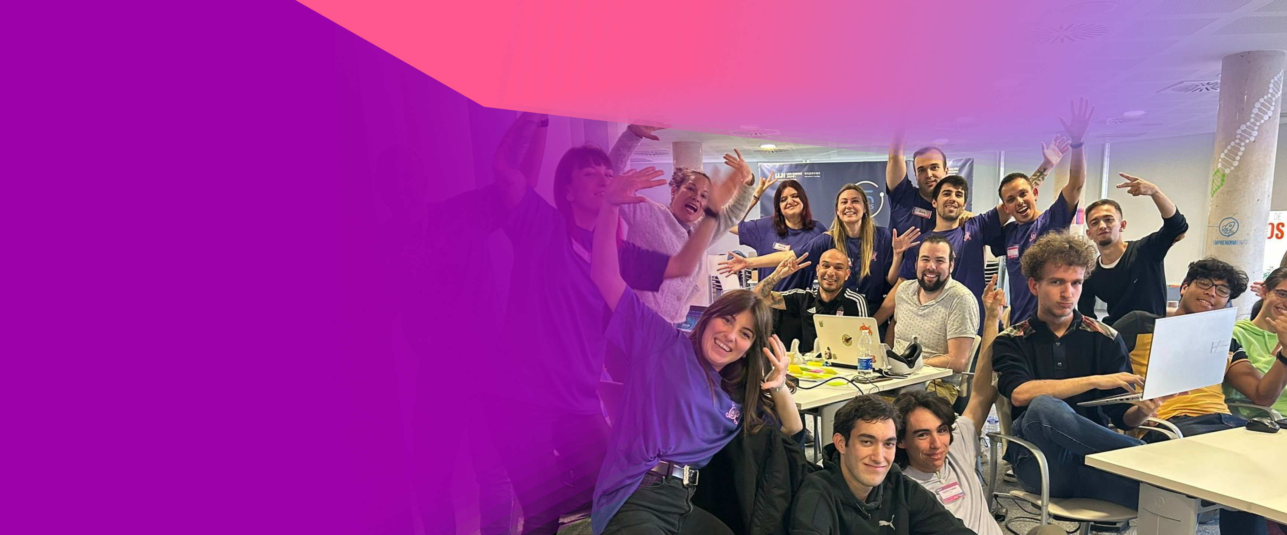


DIGITAL EDUCATION HACKATHON
FUTURE OF EDUCATION IN THE DIGITAL AGE
Presentation for DigiEduHack 2025 sponsors
[your name]
DigiEduHack 2025 Organising Host
WWW.DIGIEDUHACK.COM
DigiEduHack is an initiative under the Digital Education
Action Plan (2021-2027) of the European Commission

Slide 2


TABLE OF CONTENTS
01 - INTRODUCTION TO DIGIEDUHACK 2025
02 - CHALLENGE CATEGORIES
03 - OVERVIEW OF FIRST 5 EDITIONS
04 - KEY PROJECT MILESTONES
05 - TIMETABLE AND ACTIVITIES
06 - REASONS TO JOIN AS A SPONSOR
07 - SPONSOR PACKAGES

Slide 3


01
  DigiEduHack is a flagship initiative of the Digital Education Action Plan of the European Commission: it is a series of online, offline, and blended format hackathons happening all around the world for a period spanning 10 days (from 7-16 November 2025), focusing on the future of education in the digital age. DigiEduHack exists to contribute solutions to challenges in the digital education field. There have been five editions of DigiEduHack prior to 2025.
  The format of DigiEduHack is inspired by original hackathons, with a twist, to make the events the most accessible, sustainable and inclusive possible: local DigiEduHack hosts craft their challenge from among the 9 proposed challenge categories and can decide the format of their hackathon in order to suit their participants the best, keeping the needs of their communities in mind.

Slide 4
02
CHALLENGE CATEGORIES
  Access and Availability
  Learning Spaces and Pedagogies
  The Learning Experience
  Individual Competencies
  Organisational Capability
  Well-being in Digital Education
  Emerging Technologies for Education
  Data-Driven Education
  Other
  Detailed category descriptions can be found here: https://digieduhack.com/about

Slide 5


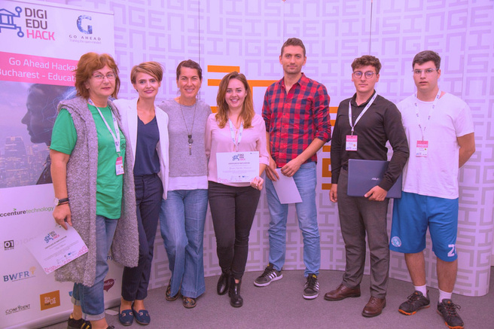
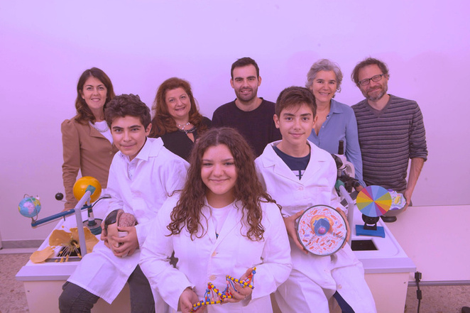
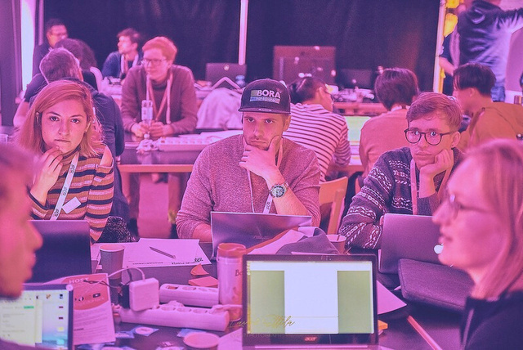
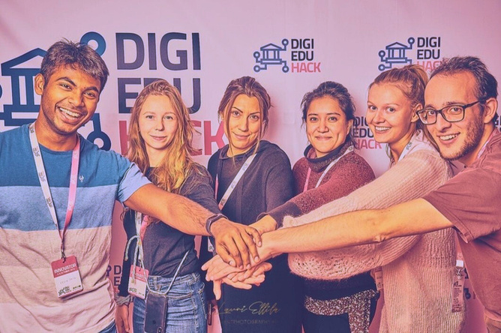


03
OVERVIEW
(FIRST 5 EDITIONS)
10.178
1322
306
232
participants
solutions created
host organisations
local events

Slide 6
04
KEY PROJECT MILESTONES
April
June
August
October
December
March
Registration to host the hackathon started
Craft your challenge
Create your website
Solution evaluation
Awarding ceremony
Recruit participants, mentors, jury and possibly sponsors
Onboard teams, mentors and jury
Register to host the hackathon
Early planning
Recruit participants, mentors, jury and possibly sponsors
Hold challenge webinar (recommended)
Host registration closes
Public voting
DigiEduHack days: 7-16 November
Main Stage Event
May
July
September
November
January

Slide 7









05
TIMETABLE AND ACTIVITIES
TIMETABLE AND ACTIVITIES
Select
sponsorship
package
Optional:
Participate
in a local jury
Interest to join
as sponsor
Confirm
sponsorship
Sponsor
briefing
Promote the
event
Join the event
Debrief
after the event

Slide 8
06
REASONS TO JOIN
  Get a chance to influence the direction of where digital education across Europe is heading
  Join forces with European Commission, consortium members, and other local partners to support hackathon participants in building the educational solutions of the future
  Get visibility for your brand and join the most exciting education event of 2025!
  Recruitment: Get to know participants and top talent locally
  Expand your own and your company’s network and get to know key people within the education sector locally and across Europe

Slide 9
07
SPONSOR PACKAGES
We offer various sponsorship tiers designed to provide maximum visibility and value for your investment:
Platinum Sponsor - [Sponsorship Amount]
Prominent logo placement on event
materials, webpage, and social media channels
Opportunity to deliver a keynote speech at the event
Exclusive access to participants for recruitment purposes
[Additional benefits tailored to the sponsor's needs]
We would be happy to discuss these
sponsorship opportunities further and customise a package that aligns with your
organisation's goals and interests.
Gold Sponsor - [Sponsorship Amount]
Logo placement on event materials, webpage, and social media channels
Opportunity to host a workshop or panel discussion during the event
Access to participants' project submissions for review and feedback
[Additional benefits tailored to the sponsor's needs]
Silver Sponsor - [Sponsorship Amount]
Logo placement on event materials and website
Opportunity to provide branded merchandise or promotional materials to participants
Access to event photos and videos for promotional purposes
[Additional benefits tailored to the sponsor's needs]

Slide 10
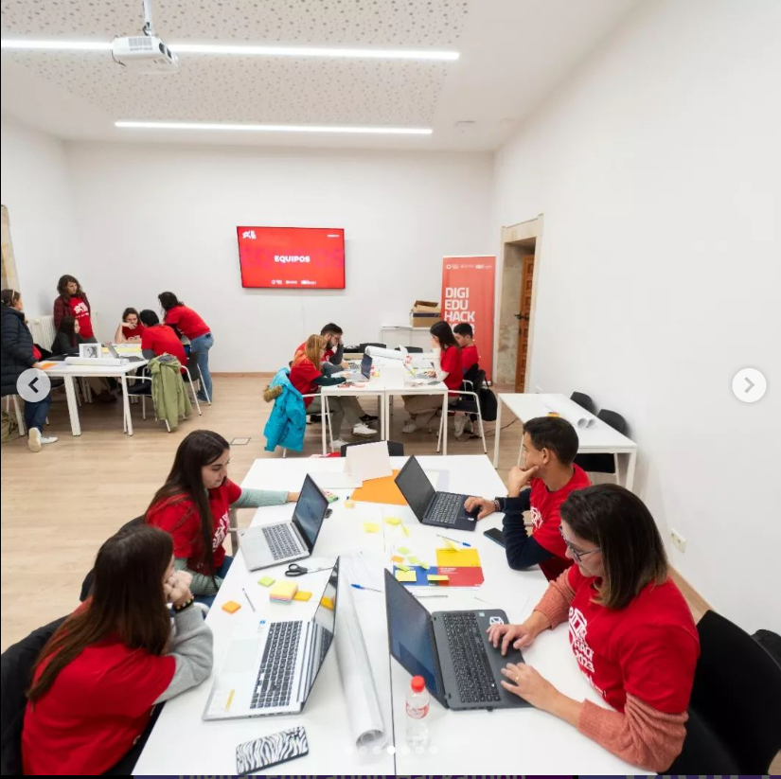


LEARN MORE
digieduhack.com
CONTACT US
contact@digieduhack.com

